Slide 1


Data Tagging & Deduplication Queries
29 Jan 2026

Slide 2
Job deduplication workflow
4
Set deduped id to the matching job
1
2
3
Yes
Clean job descriptions and apply mini hash
Compare mini hash with jobs inserted past 60 days
Check if similarities
> 90%?
No
4
Insert the mini hash and job id into mini hash database

Slide 3
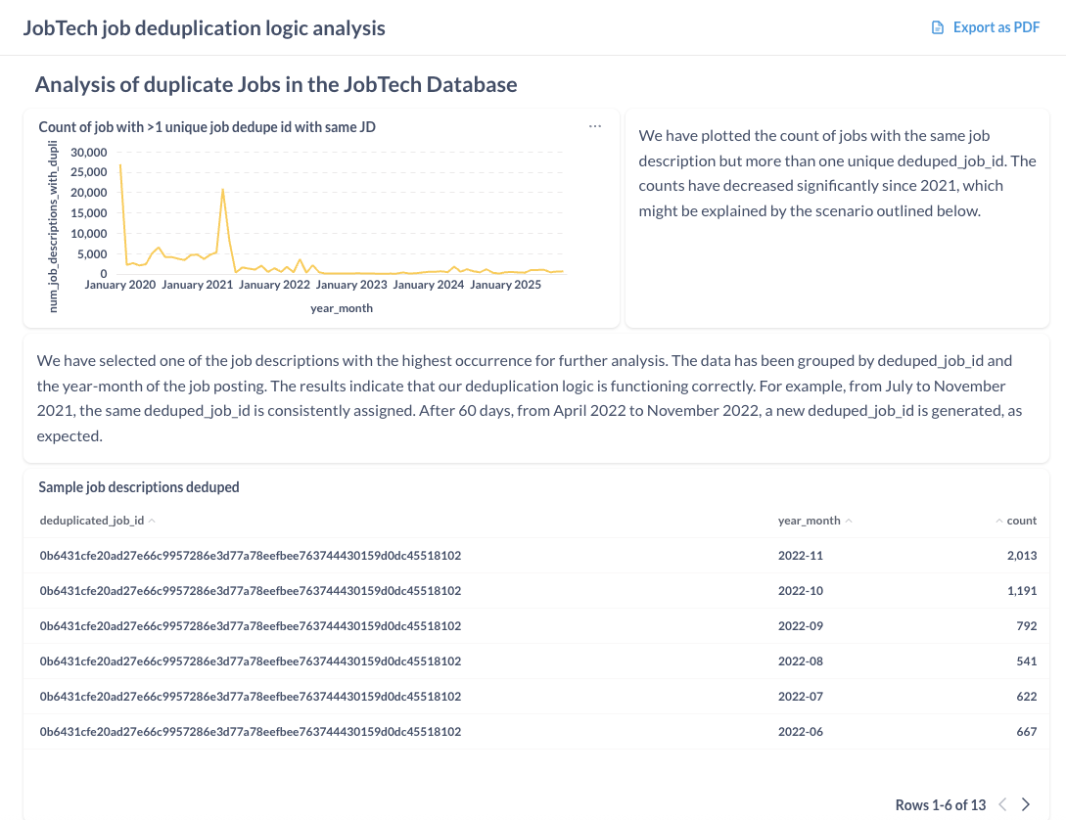
Job deduplication algorithm analysis
Link to dashboard:
https://analytics.betalented.ai/public/dashboard/10ff3837-491c-41da-9c10-334e5d7c05a8

